Slide 1
RFID for dummies
Radio-frequency identification
A Sam and Dwend Presentation
Initialize

Slide 2
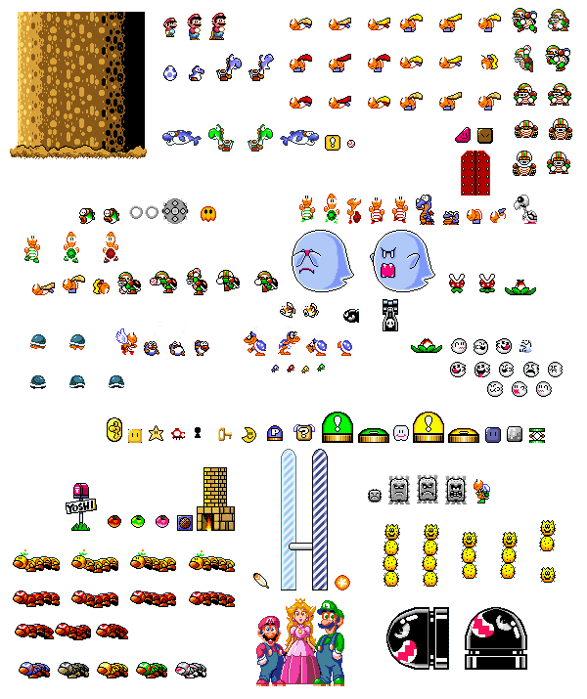
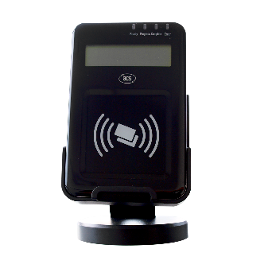


History of RFID
Notes:
The first iteration of modern RFID was patented on January 23, 1973 by Mario Cardullo. The basic Cardullo patent covers the use of RF, sound and light as transmission media.
However, RFID has existed as early as the 1940s:
RADAR was widely in use by the Americans, Germans, Japanese and British but there was no way to determine whether an aircraft was an enemy.
Apparently, the Germans discovered that if they rolled their aircraft as they returned to base they could create a unique radio signal which allowed German ATCs to determine whether aircraft was friend or foe using what is essentially the first passive RFID system.
The British developed the first active IFF (Identify Friend or Foe) system – a transmitter was placed on every British plane and as the plane entered British airspace, it broadcasted a signal that could be identified as friendly.
By the 1970s, the US government was also working on RFID systems; the energy department deployed transponders – which essentially communicate a signal to a receiver – to nuclear waste trucks. The transponders would respond with an ID and various other data about the nuclear materials.

Slide 3
How does RFID work?
The tag hath been scanned!
Notes:
There are two types of tag: Active and Passive.
The protocol uses electromagnetic fields to identify RFID ‘tags’.
The tags contain electronically-stored digital information.
[Most of the content is in the video]

Slide 4
What is the significance RFID?
Notes:
In 2014, the RFID market was worth US$8.89bn.
GVR has projected that the market value will rise to US$40.5bn by 2025.
According to CYBRA (a company selling RFID and Barcode labelling software):
In the US, 96% of retailers have plans to start tagging apparel with RFID.
In stores, RFID has been known to lift Inventory Accuracy up to 95 percent or better.
In 2017, it is estimated that nearly 8 billion RFID tags were purchased, in the retail space alone.

Slide 5
Uses of RFID
Theft detection
Replacement for barcodes
Cars (keyless entry)
Processing and tracking goods
Data transfer
Sam’s blood sugar monitor
Notes:
RFID is used in shops and libraries to prevent theft.
It is also used as a replacement for barcodes in some places. Such as on advertisements.
In the transport industry it is used for keyless entry.
Warehouses and Postal Services can process and track stock and goods more quickly and efficiently.
NFC devices use this protocol for data transfer.

Slide 6
Issues with RFID

Slide 7


Sam and Dwend’s
RFID
“ ”
Notes:
FACT: Sam was awake until 2am completing this.

Slide 8
Who first patented RFID? (2)
Mario Cardullo
Luigi Cardullo
Naughty nicknames beware! (Sam hasn't actually coded a kicking mechanism but please respect the fact he stayed up until 2am to make this.)
1 team(s) have joined the game.
Last Updated: 01/14/12019 HE 12:32:18
Joined Teams:
Elloot
Mrs McCathie
The country of Germany.

